Slide 1
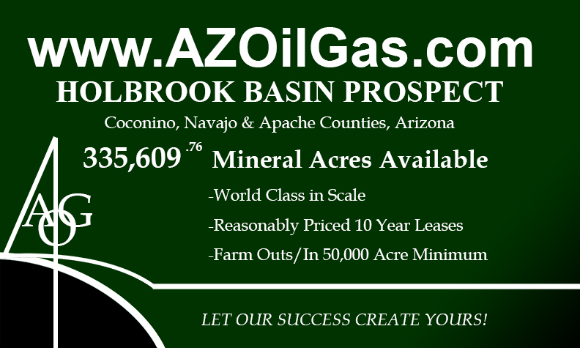

Slide 2
www.AZOilGas.com
TERMS:
335,609.73 Acres of Oil & Gas Leases
10 Year Leases/Appx. 9 Year Remaining
Leases are sold into Joint Venture at an 80% NRI
AOG affiliates would retain 10%-25% of the Working Interest
Price per acre is $200.00/Acre- $67,121,952.00

Slide 3
www.AZOilGas.com
TERMS:
10 Year Leases have additional 5 year shut-
in provision for infrastructure.
Can be unitized by production from two wells, into multiple thousands of acre tracts.
Six stacked pay-zones in the Permian & Devonian from 1,000’-4,000’.
Standard vertical drills <$650,000.00 each.
Willing to negotiate a fair joint-venture.

Slide 4
www.AZOilGas.com
Why Hasn’t The Holbrook Basin Already Produced?
The first well drilled in Arizona was around the turn of the century.
It took three years of promoting money, and drilling 500’ deeper to abandon the well as a dry-hole.
The next concerted effort to drill didn’t occur until the 1960’s when Kerr McGee brought in a number of 1,000 – 3,000 BOPD wells on the Dineh Bi Keyah field in NE Arizona.

Slide 5
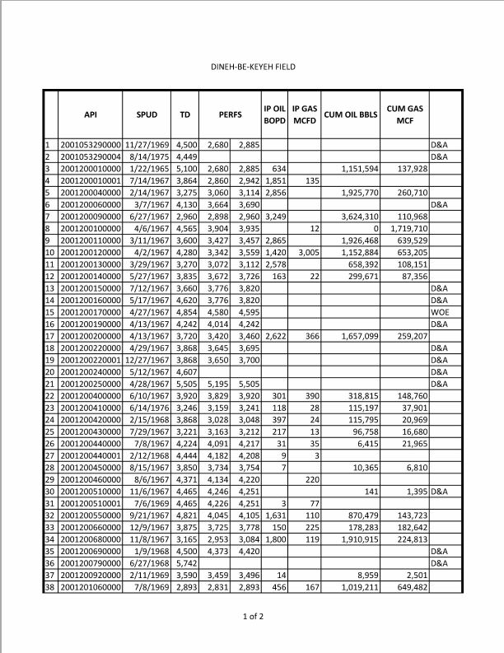
www.AZOilGas.com
Dineh Bi Keyah Production:
34 Productive Wells
4 Square Miles:
2,898-2,960
3,427-3,457
2,860-2942
Perfs
3,060-3,114
2,578 BOPD
456 BOPD
IP
1,800 BOPD
3,249 BOPD
2,856 BOPD
2,865 BOPD
1,420 BOPD
118-397
BOPD
1,851 BOPD
2,622 BOPD
1,631 BOPD
CUMULATIVE:
870,479 Bbls
1,657,099 Bbls
1,151,594 Bbls
3,624,310 Bbls
1,926,468 Bbls
1,152,884 Bbls
1,910,915 Bbls
1,019,211 Bbls
658,392 Bbls
318,815 Bbls
115,197 Bbls
96,758 Bbls
115,795 Bbls

Slide 6
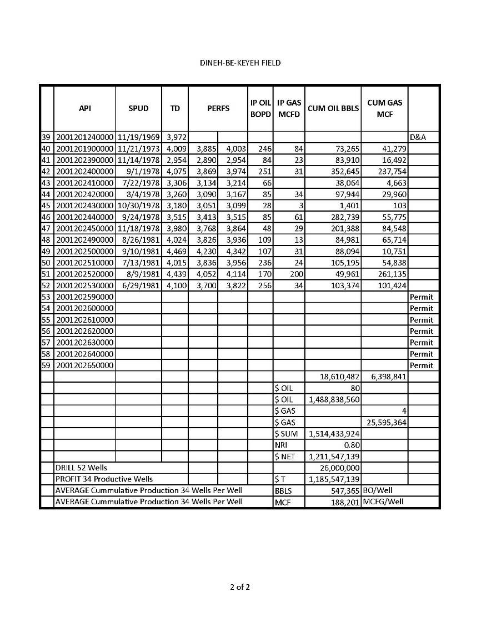
www.AZOilGas.com
Dineh Bi Keyah Production:
34 Productive Wells
4 Square Miles:
At $80 Oil and
$4 Gas, DBK’s
Adjusted Eco-
nomic impact
is $1.5 Billion
DBK averaged
547,000+BOPW
& 188,000+MCF
And the most
Stunning fact…
It Produced from VOLCANICS!
IP
256 BOPD
246 BOPD
251 BOPD
109 BOPD
107 BOPD
236 BOPD
170 BOPD

Slide 7
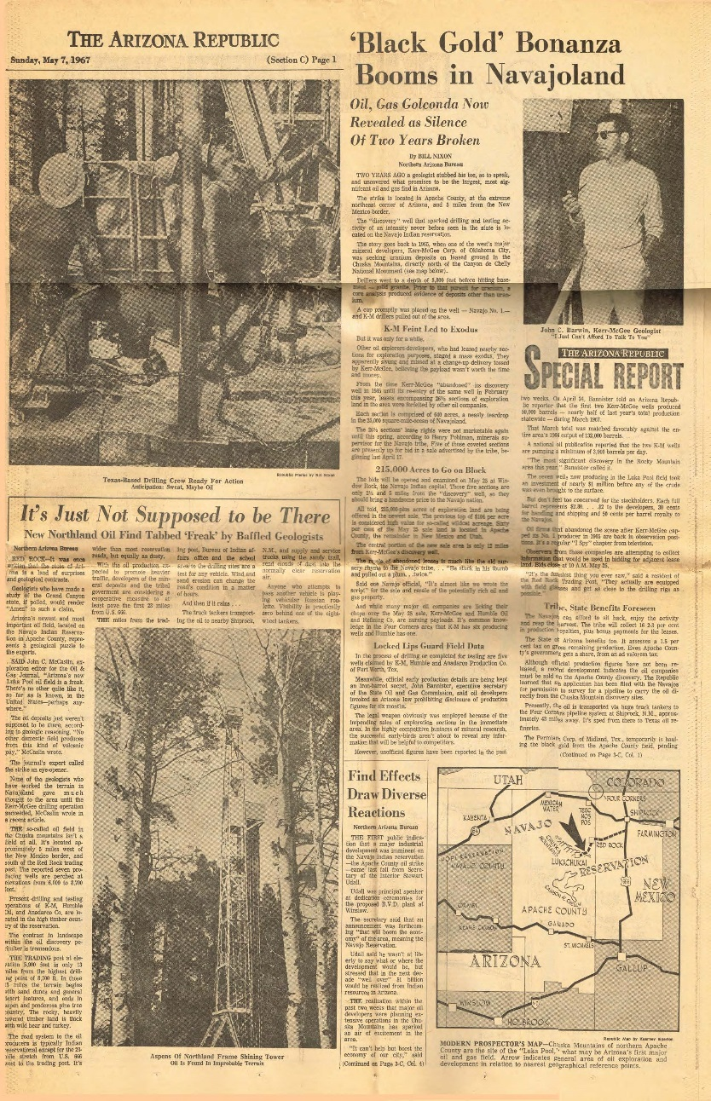
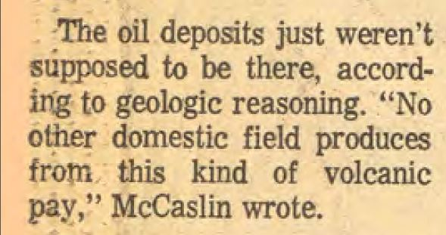
www.AZOilGas.com
Dineh Bi Keyah Production:
34 Productive Wells
4 Square Miles:

Slide 8
www.AZOilGas.com
Dineh Bi Keyah Production:
34 Productive Wells
4 Square Miles:
The 34 wells in their small four mile field have produced 18,610,482 Bbls of cumulative oil and 6,398,841 MCFG
The oil-bearing volcanic zone was
penetrated by a granite sill- which probably allowed serpentospheric chemicals to migrate upward and react with water, generating hydrocarbons under conditions
of heat and pressure at depth, which
then migrated up the sill, into the
reservoir.
We believe this to be an analogue to the
Holbrook Basin, which is underlain by the
Serpentosphere, and communicated with
through numerous faults, granite intrusives,
and old breccia pipes.
For more on this, see Stanley B. Kieth’s
Paper on Serpentospheric generation of oil.

Slide 9
www.AZOilGas.com
Why Hasn’t The Holbrook Basin Already Produced?
The fever of the Dineh Bi Keyah strike in 1967 drove lease prices to $3,000.00/acre.
Companies went to the Holbrook Anticline and drilled on and around its crest.
The error in this is that the surface anticlines have very little correlation to the Supai or Devonian structures which underlie it.

Slide 10
www.AZOilGas.com
Why Hasn’t The Holbrook Basin Already Produced?
One DST was run on a show of oil on a hard streak above the porous rock.
They didn’t test the reservoir.
They tested a show that they got from leakage from the reservoir.
Another DST was run over 200’ at a time.

Slide 11
www.AZOilGas.com
Why Hasn’t The Holbrook Basin Already Produced?
Of the few wells drilled in the several thousand mile area:
The stratigraphy has been unstandard.
The zones picked by drillers have been mis-understood.
The mud-engineering has led to poor cuttings returns.
There has not been a comprehensive, accurate understanding of the geology of the Holbrook Basin before AOG’s.

Slide 12
www.AZOilGas.com
Why Hasn’t The Holbrook Basin Already Produced?
These mistakes provided many shows of oil and gas.
As varies by area, following the zones updip, towards greater thickness, or greater porosity should prove productive.
There are also numerous fault-bounded blocks that merit independent testing.

Slide 13
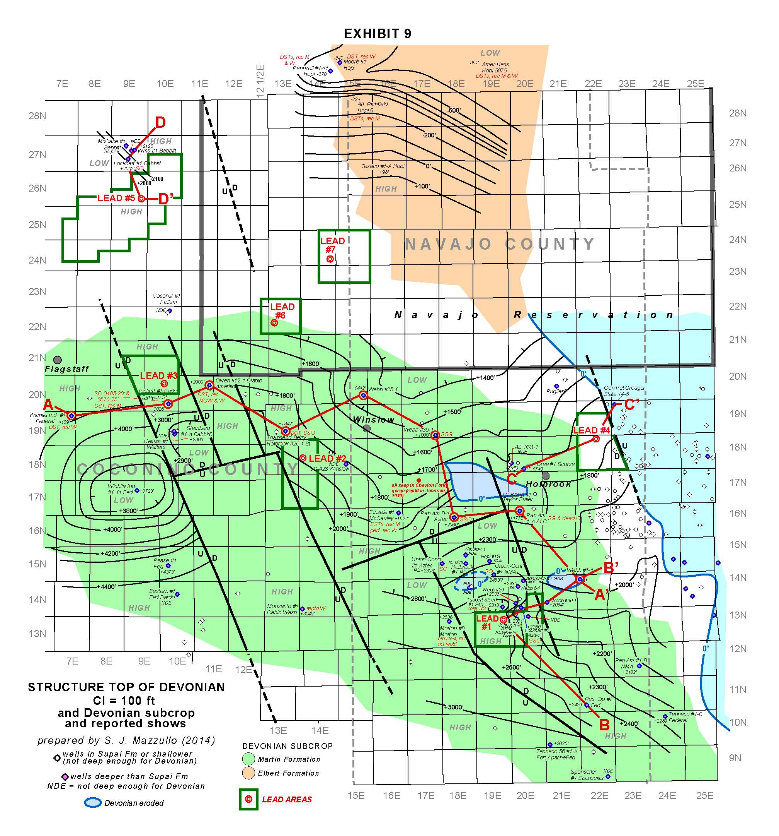
www.AZOilGas.com
N Flagstaff Contract
FIELDS:
24 wells could properly evaluate the entire basin
LEAD #5
3 Wells Per Area to Test
LEAD #4
LEAD #3
LEAD #2
LEAD #1
SW Fault
Block
SE Fault
Block

Slide 14
www.AZOilGas.com
Lead #1
Structural High
Discreet Fault Block
3 Wells Per Area to Test
Compelling Shows of Oil, Gas &
Helium in Surrounding Wells
Potential:
Mississippian Redwall Lime
Pennsylvanian Naco
Permian Supai Formation
LEAD #1

Slide 15
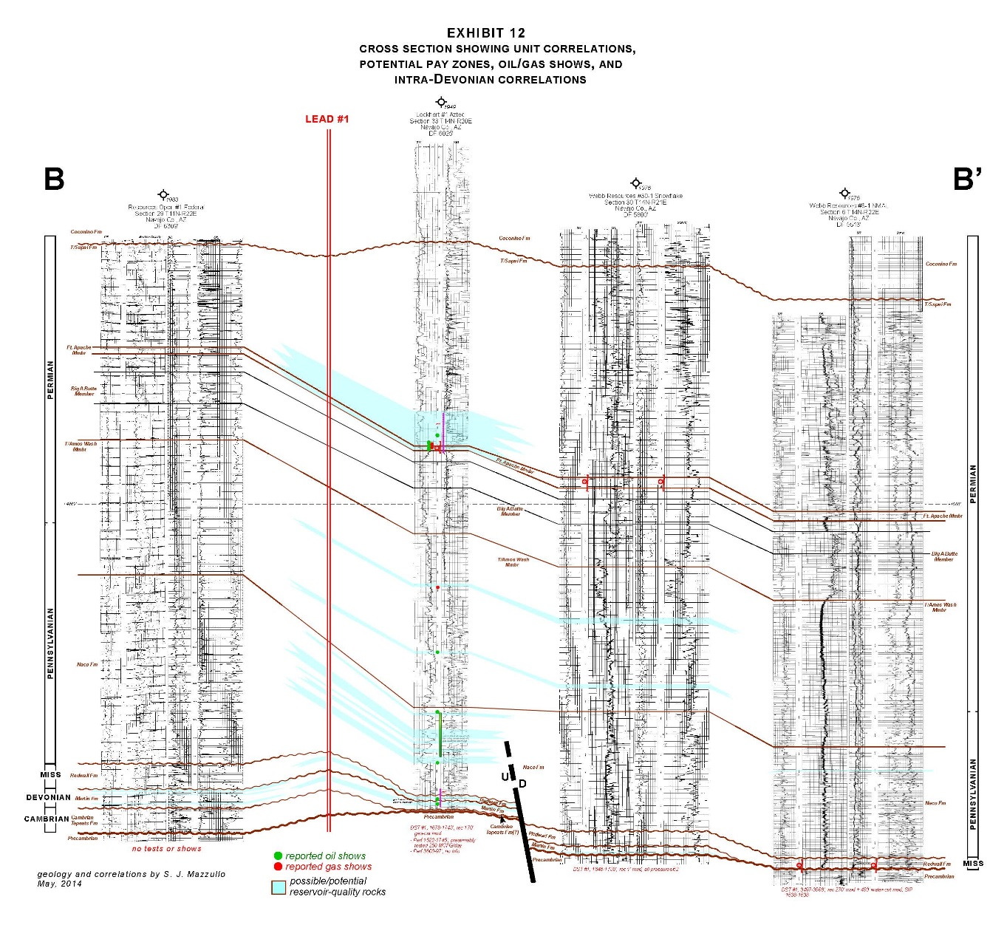
www.AZOilGas.com
Lead 1
Cross-
Section:
Updip Location
OIL SHOWS
GAS SHOWS

Slide 16
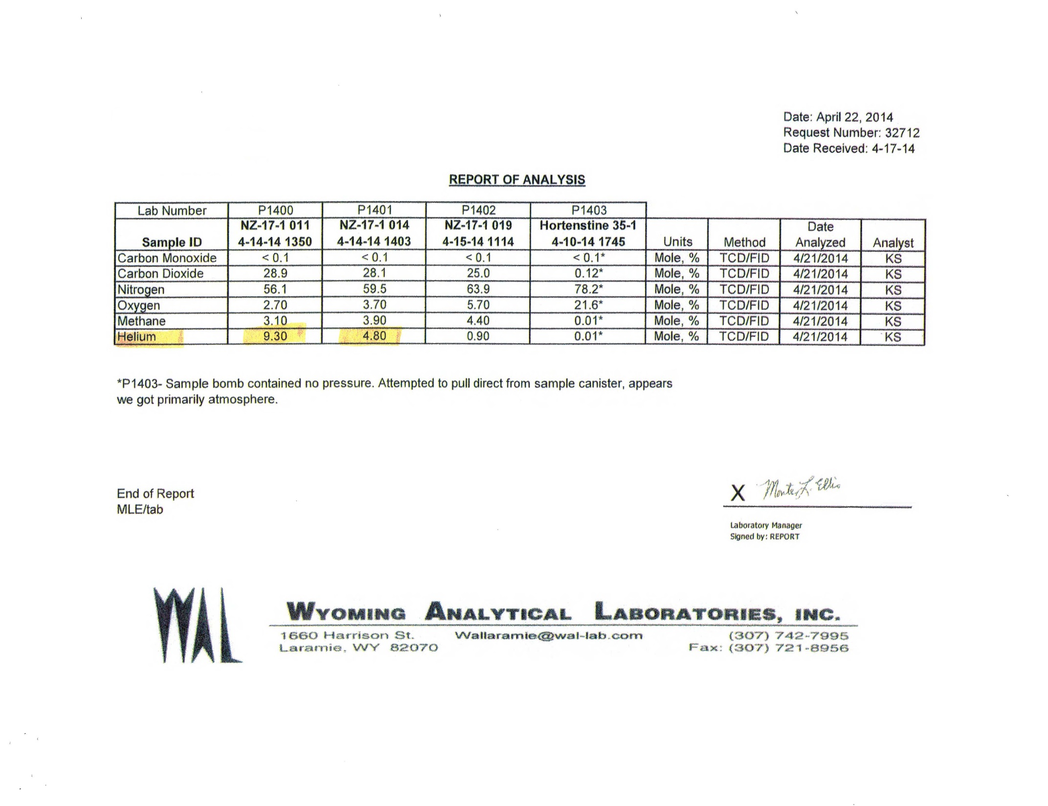
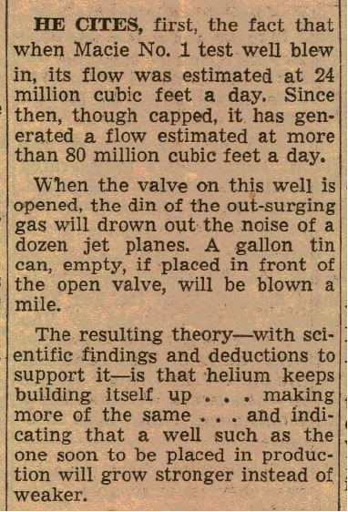
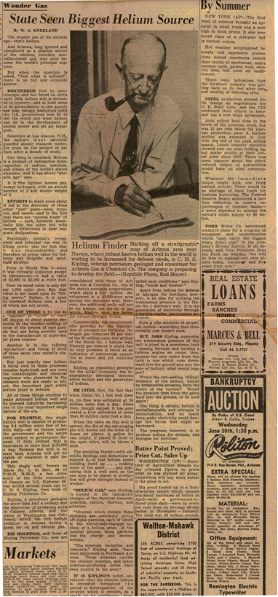
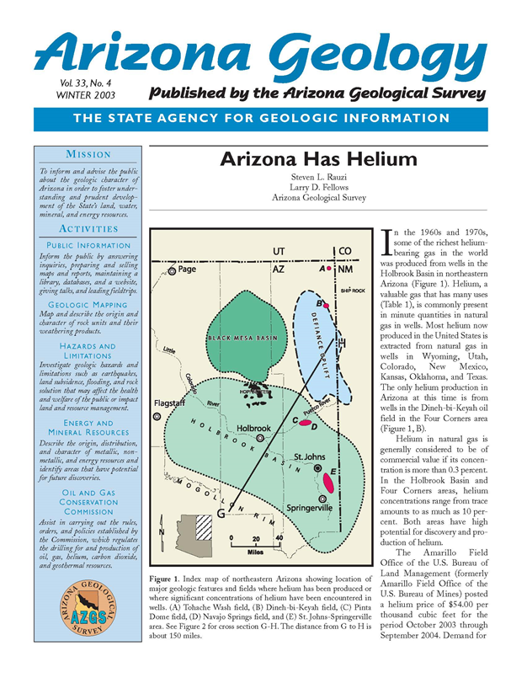
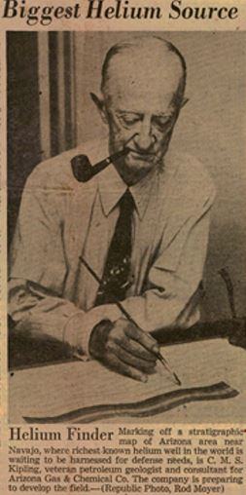
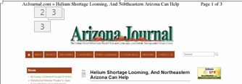
www.AZOilGas.com
Kinder-Morgan has planned a pipeline to carry CO2
to Texas from their wells in the Holbrook Basin for EOR
This Well Was Drilled in the Holbrook Basin in 2004
4.8 – 9.3 % Helium amounts to some of the richest
in the world.
The Holbrook Basin is known to be
one of the most promising areas in
North America to look for Helium
Reserves.
Found at a depth of around 1,000’ in
the Coconino sandstone, helium
production in the Holbrook Basin
has historically been prolific.
Specifically, the Pinta Dome structure
has the highest concentrations of
helium in the world.
At 6 - 8.8% helium by content, the Pinta
Dome is the only field in the world drilled
specifically for its helium content.
CO-
TARGET:
HELIUM
Nine wells cumulatively produced
6,532,336 Mcfg
LEAD #1

Slide 17
www.AZOilGas.com
Lead #2
Structurally High
3 Wells Per Area to Test
Compelling Shows of Oil and Gas
In the Devonian and the Supai
LEAD #2

Slide 18
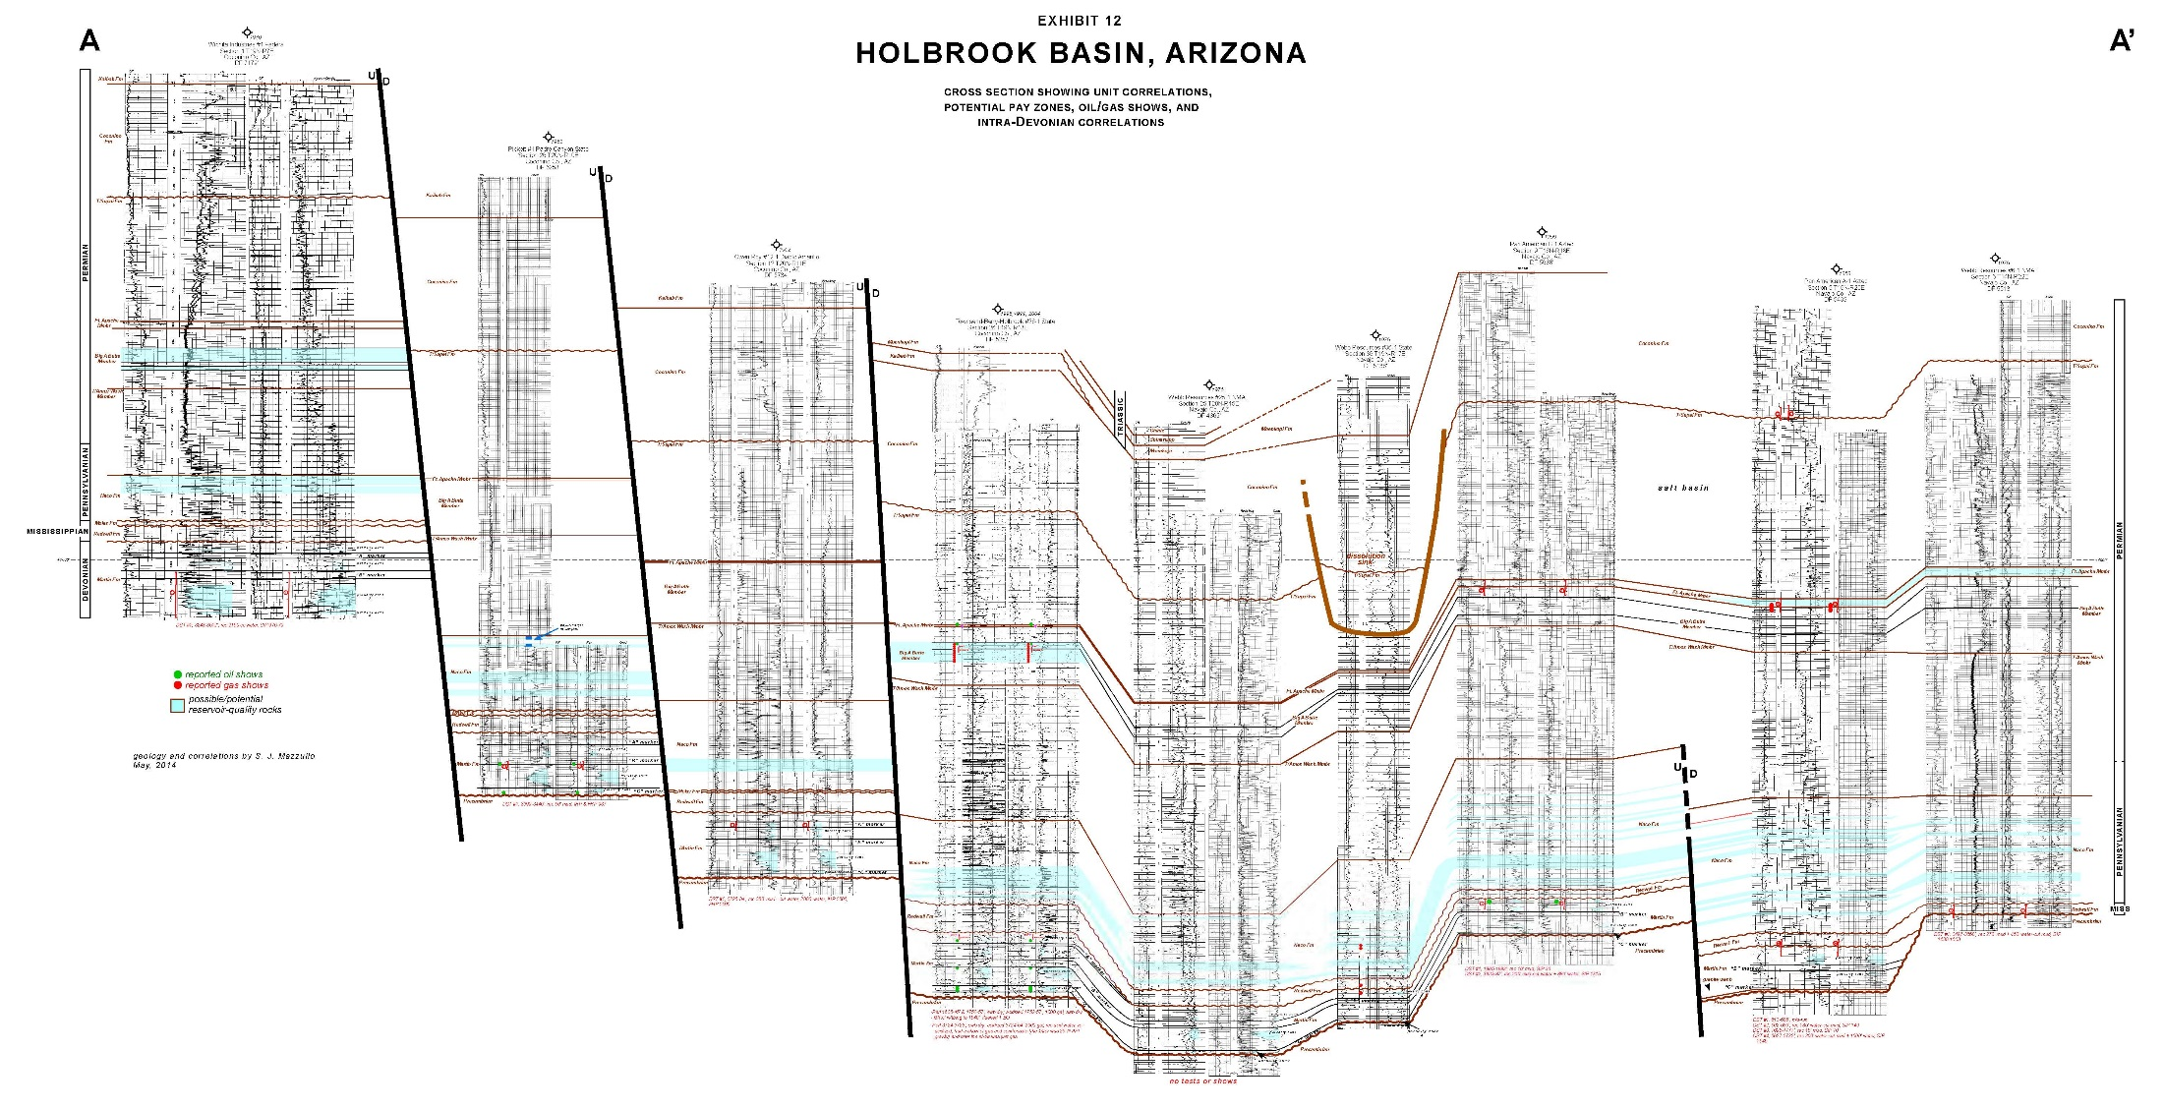
LEAD 2:
Cross-Section
OIL SHOWS
3 Wells Per Area to Test

Slide 19
www.AZOilGas.com
Lead #3
3 Wells Per Area to Test
LEAD #3
Structurally High
Located on a Discreet Fault-Block
Shows of Oil Largely Untested
Best Porosity in Devonian Untested
Possible Reservoir in the Supai

Slide 20
LEAD 3:
Cross-Section
3 Wells Per Area to Test
OIL SHOWS

Slide 21
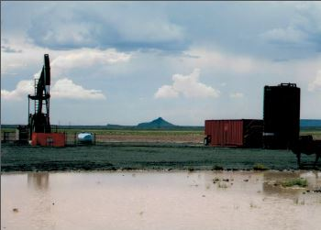
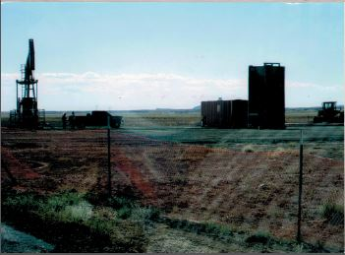
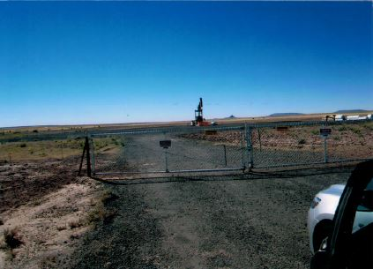
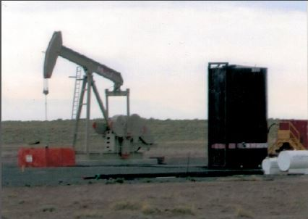
www.AZOilGas.com
Lead #4
3 Wells Per Area to Test
Brand New Well Recently POP
LEAD #4
Fault Bounded Structural High
Located Near Only Newly Equipped
Well Recently Completed as Tight-
Hole

Slide 22
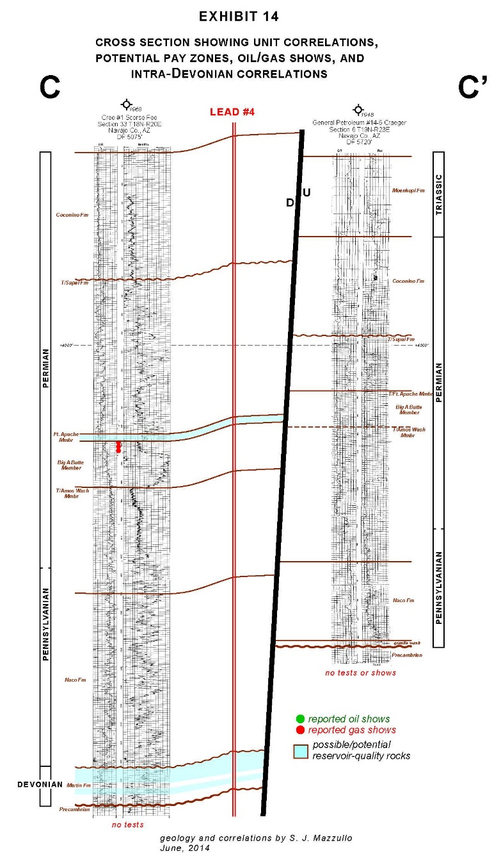
www.AZOilGas.com
Updip Location
Lead 4
Cross-
Section:
GAS SHOWS

Slide 23
www.AZOilGas.com
Lead #5
LEAD #5
3 Wells Per Area to Test
Gravity High In the Coconino
Oil Shows in Nearby Structurally
Lower Wells
3rd Pay Target in the Supai

Slide 24
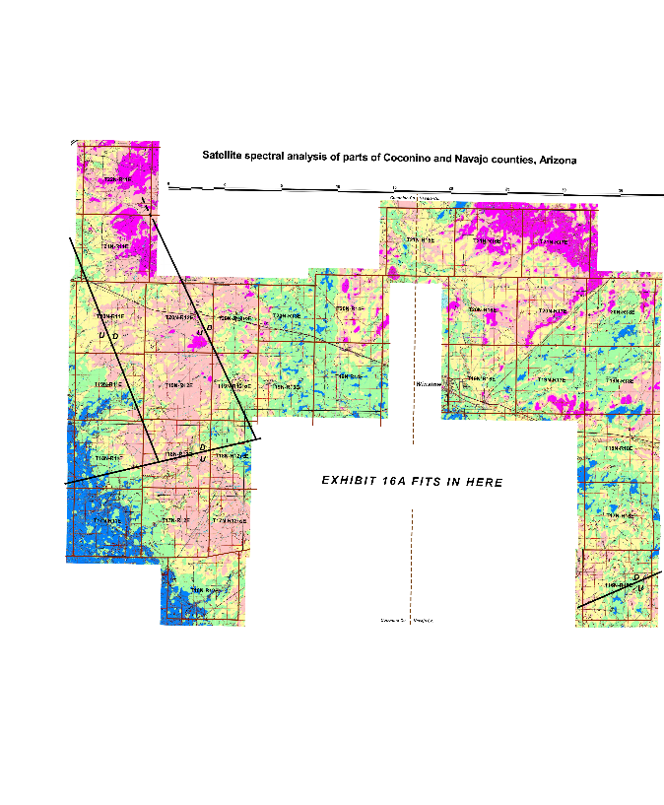
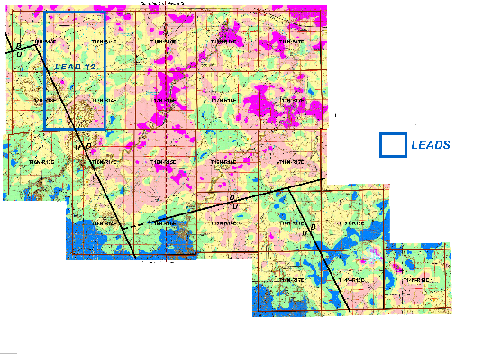
Vegetation Anomalies,
Surface Alteration Through Macro/
Micro-Seeping Gasses,
Direct Detection and Ratioing of These
Gasses,
Ratioing of Polarizations of Radar-
All Stack on the Geology and Present:
Red: Oil Reservior
Pink: Oil Reservior with Natural Gas
Yellow: Gas Reserves
SW Fault-
Block
Only One Exploratory Well Penetrated
Deeper than the Supai.
3 Wells Per Area to Test
Hyperspectral Satellite Analysis &
Radar-Sat Show Prolific Potential on
This Massive, Fault Bounded Struture
SW Fault
Block

Slide 25
SE Fault-
Block
3 Wells Per Area to Test
Only One Exploratory Well Penetrated
Deeper than the Supai.
Test Results Not Reported
Last Signficant, Fault Bounded Area
That Merits Testing
SE Fault
Block

Slide 26
ARIZONA OIL AND GAS
www.AZOilGas.com
Come Visit Us At Booth
841
CARMON DECKER BONANNO, President
11 North Saint James Place
Eastborough, Kansas 67206
PH: 816 – 223 – 3712
FX: 316 – 260 – 1960
CarmonBonanno@Hotmail.com

