Slide 1


www.AZOilGas.com
ARIZONA OIL AND GAS
NORTH DOUGLAS PROSPECT
Sulphur Springs Valley
Cochise County, Arizona
56,726 Mineral Acres Available
-World Class In Scale
-Ten Year Leases
-Farm Outs/In

Slide 2
TERMS:
50/50 Joint Venture Available
www.AZOilGas.com
• 57,991 Acres Oil and Gas Leases
• Ten Year Term With Seven Years Remaining
On Most Leases
Leases Are Sold Into Joint Venture At 80%
NRI
AOG Affilliates To Retain 10% - 50% Of
Working Interest
High-Value Leases Offered At $125.00/Acre
Secondary Targets at $75.00/Acre
$3,571,733.34

Slide 3
TERMS:
    10 Year Leases have additional 5 year shut-
    in provision for infrastructure.
    Can be unitized by production from two wells, into multiple thousands of acre tracts.
    Twelve possible pay-zones in the Cretaceous, Permian & Pensylvanian down to 4,900’.
    Standard vertical drills <$700,000.00 each.
    Willing to negotiate a fair joint-venture.
www.AZOilGas.com

Slide 4
Why Hasn’t The Sulphur Springs Valley Already Produced?
www.AZOilGas.com
Many water wells drilled in SSV by ranchers and townsfolk since the late 1800s have had shows of oil and blow-outs of gas
Because of this, very few wells have penetrated deeper than 1,200’
Of the wells that have penetrated deep, many have reported shows of oil and or gas, and many of those have suffered construction failures
The only organized drilling effort occurred in the 1960’s when Kerr McGee brought in a
number of 1,000 – 3,000 BOPD wells on the Dineh Bi Keyah field in NE Arizona.

Slide 5

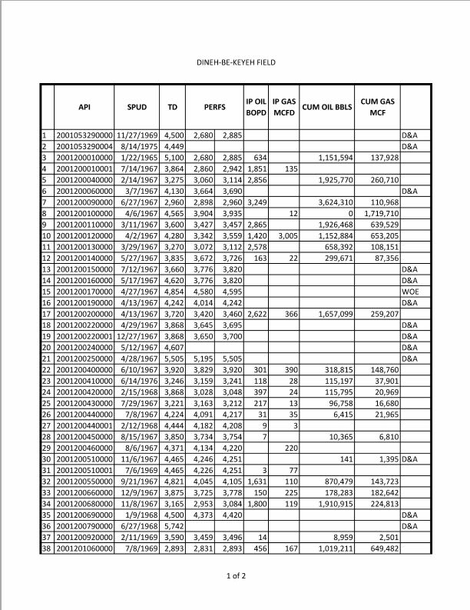
www.AZOilGas.com
Dineh Bi Keyah Production:
34 Productive Wells
4 Square Miles:
2,898-2,960
3,427-3,457
2,860-2942
Perfs
3,060-3,114
2,578 BOPD
456 BOPD
IP
1,800 BOPD
3,249 BOPD
2,856 BOPD
2,865 BOPD
1,420 BOPD
118-397
BOPD
1,851 BOPD
2,622 BOPD
1,631 BOPD
CUMULATIVE:
870,479 Bbls
1,657,099 Bbls
1,151,594 Bbls
3,624,310 Bbls
1,926,468 Bbls
1,152,884 Bbls
1,910,915 Bbls
1,019,211 Bbls
658,392 Bbls
318,815 Bbls
115,197 Bbls
96,758 Bbls
115,795 Bbls

Slide 6
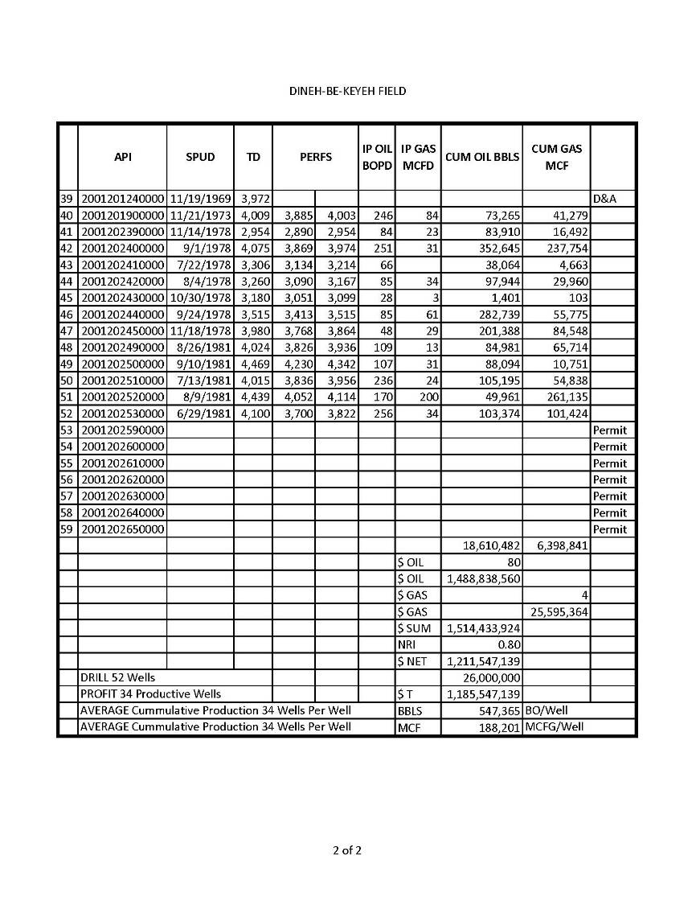
www.AZOilGas.com
Dineh Bi Keyah Production:
34 Productive Wells
4 Square Miles:
At $80 Oil and
$4 Gas, DBK’s
Adjusted Eco-
nomic impact
is $1.5 Billion
DBK averaged
547,000+BOPW
& 188,000+MCF
And the most
Stunning fact…
It Produced from VOLCANICS!
IP
256 BOPD
246 BOPD
251 BOPD
109 BOPD
107 BOPD
236 BOPD
170 BOPD

Slide 7
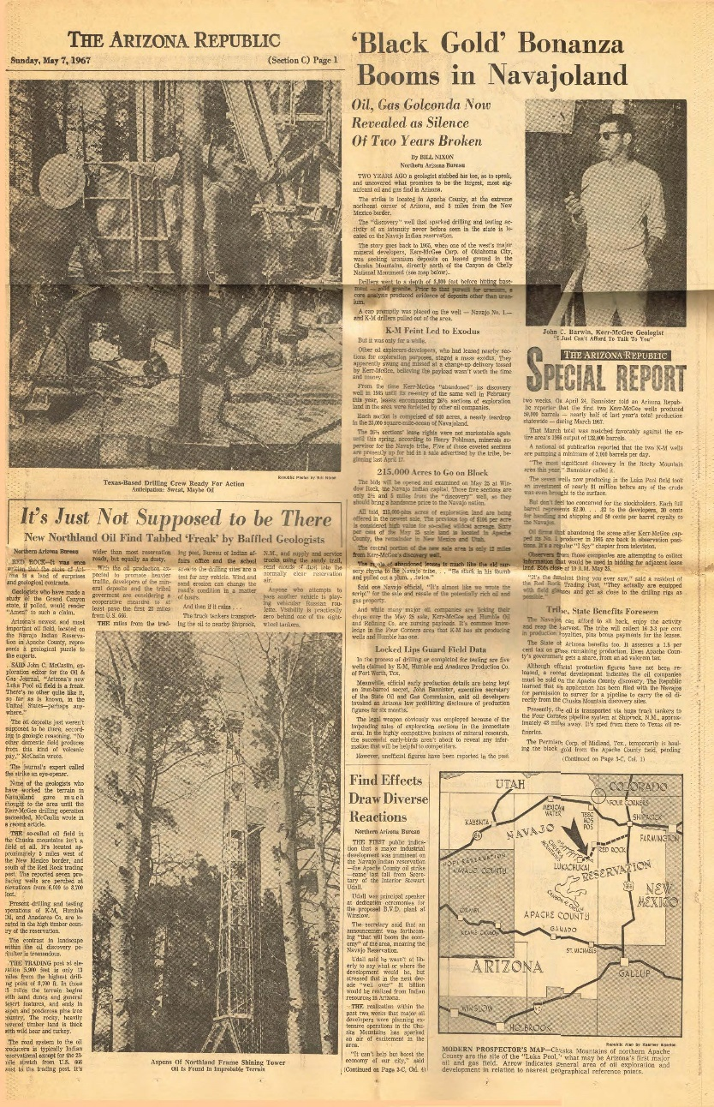

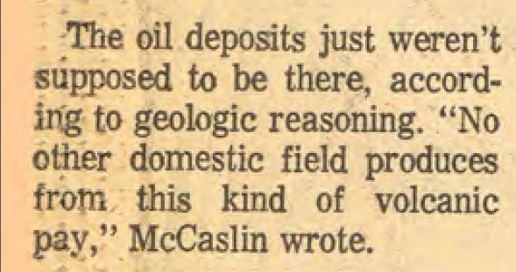
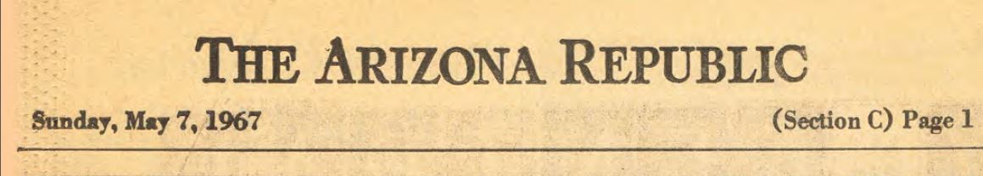
www.AZOilGas.com
Dineh Bi Keyah Production:
34 Productive Wells
4 Square Miles:

Slide 8
www.AZOilGas.com
Dineh Bi Keyah Production:
34 Productive Wells
4 Square Miles:
The 34 wells in their four mile field have produced 18,610,482 Bbls of cumulative oil and 6,398,841 MCFG
The oil-bearing volcanic zone was
penetrated by a granite sill- which probably allowed serpentospheric chemicals to migrate upward and react with water, generating hydrocarbons under conditions
of heat and pressure at depth, which
then migrated up the sill, into the
reservoir.
This helps to dispel the illusion that many oil-geologists share about the value of Arizona as an oil state.
For more on this, see Stanley B. Kieth’s
Paper on Serpentospheric generation of oil.

Slide 9
Why Hasn’t The Sulphur Springs Valley Already Produced?
www.AZOilGas.com
The fever of the Dineh Bi Keyah strike in 1967 drove lease prices to $3,000.00/acre.
It is the only production in the state of Arizona from which any facts can be drawn.
It is referenced in our geology report that the SSV appeares to be favorable for the generation, migration and entrapment of hydrocarbons.
  The SSV is the same type of graben in which a number of prolific fields produce in the SW United States-notably the Railroad Valley in Nevada where wells flow 2,000-4,000 BOPD

Slide 10
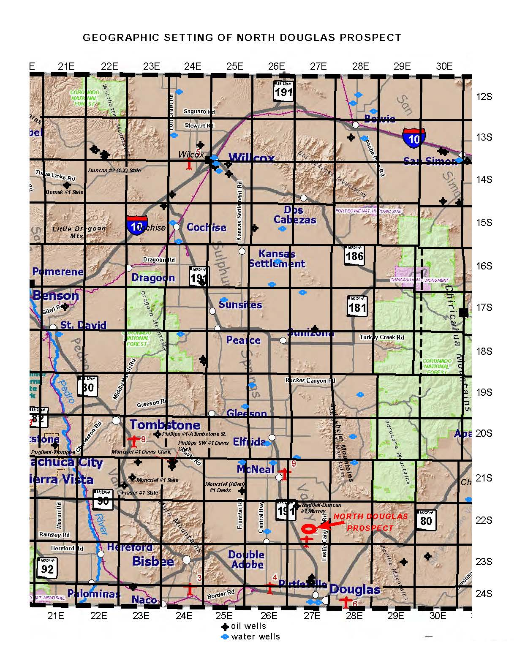
NORTH DOUGLAS PROSPECT:
www.AZOilGas.com
GEOGRAPHY:
TOMBSTONE
NORTH DOUGLAS PROSPECT
ELFRIDA
BISBEE
DOUGLAS

Slide 11
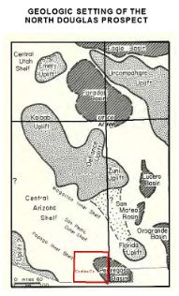
NORTH DOUGLAS PROSPECT:
www.AZOilGas.com
REGIONAL SETTING:
According to numerous studies, the Pedragosa Basin and adjoining area in Coshise County, Arizona are considered to be potential oil-producing proviences based on favorable geologic setting and oil/gas maturation history.
Located in Coshise County in southeastern Arizona on the edge of the Pedragosa Basin, which is a Paleozoic age feature where thick deposits of Pennsylvanian and Permian rocks were deposited in a rapidly-supsiding, relatively
deep basin.

Slide 12
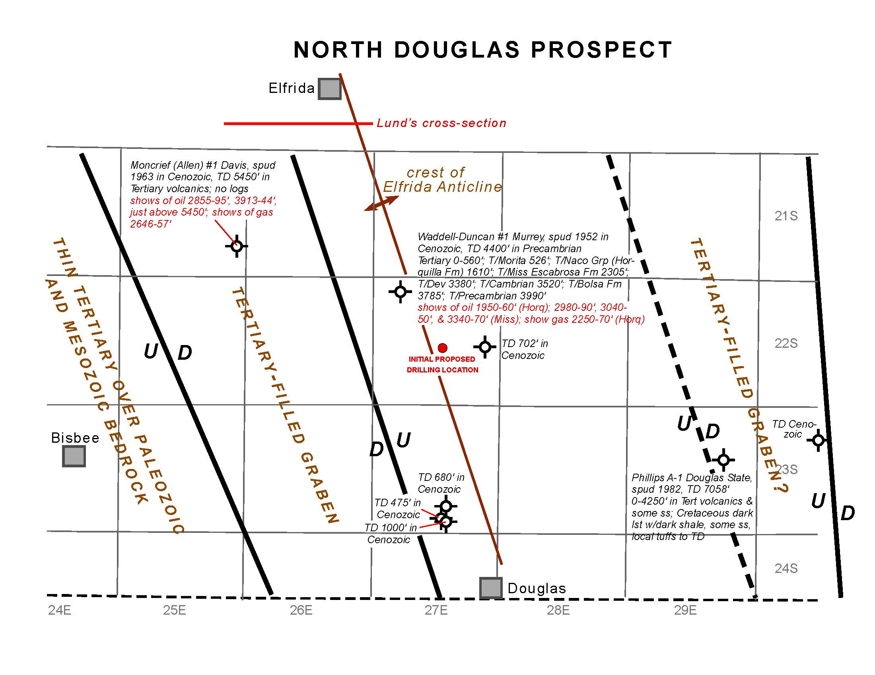
Structural Geology:
www.AZOilGas.com
Fault Bounded Grabens
Deep Tests
Elfrida Anticline
Shallow Offsets
Proposed Drilling Location
PH Lund’s Cross-Section
Crest of Anticline
OIL SHOWS:
1950’ - 60’
2980’ - 90’
3040’ - 50’
3340’ - 70’
GAS SHOWS
2250’ - 70’
GAS SHOWS
2646’ – 57’
OIL SHOWS:
2855’ - 95’
3913’ - 44’
Just Above
5450’
TD 702’
TD 1,000’
TD 680’
TD 475’

Slide 13
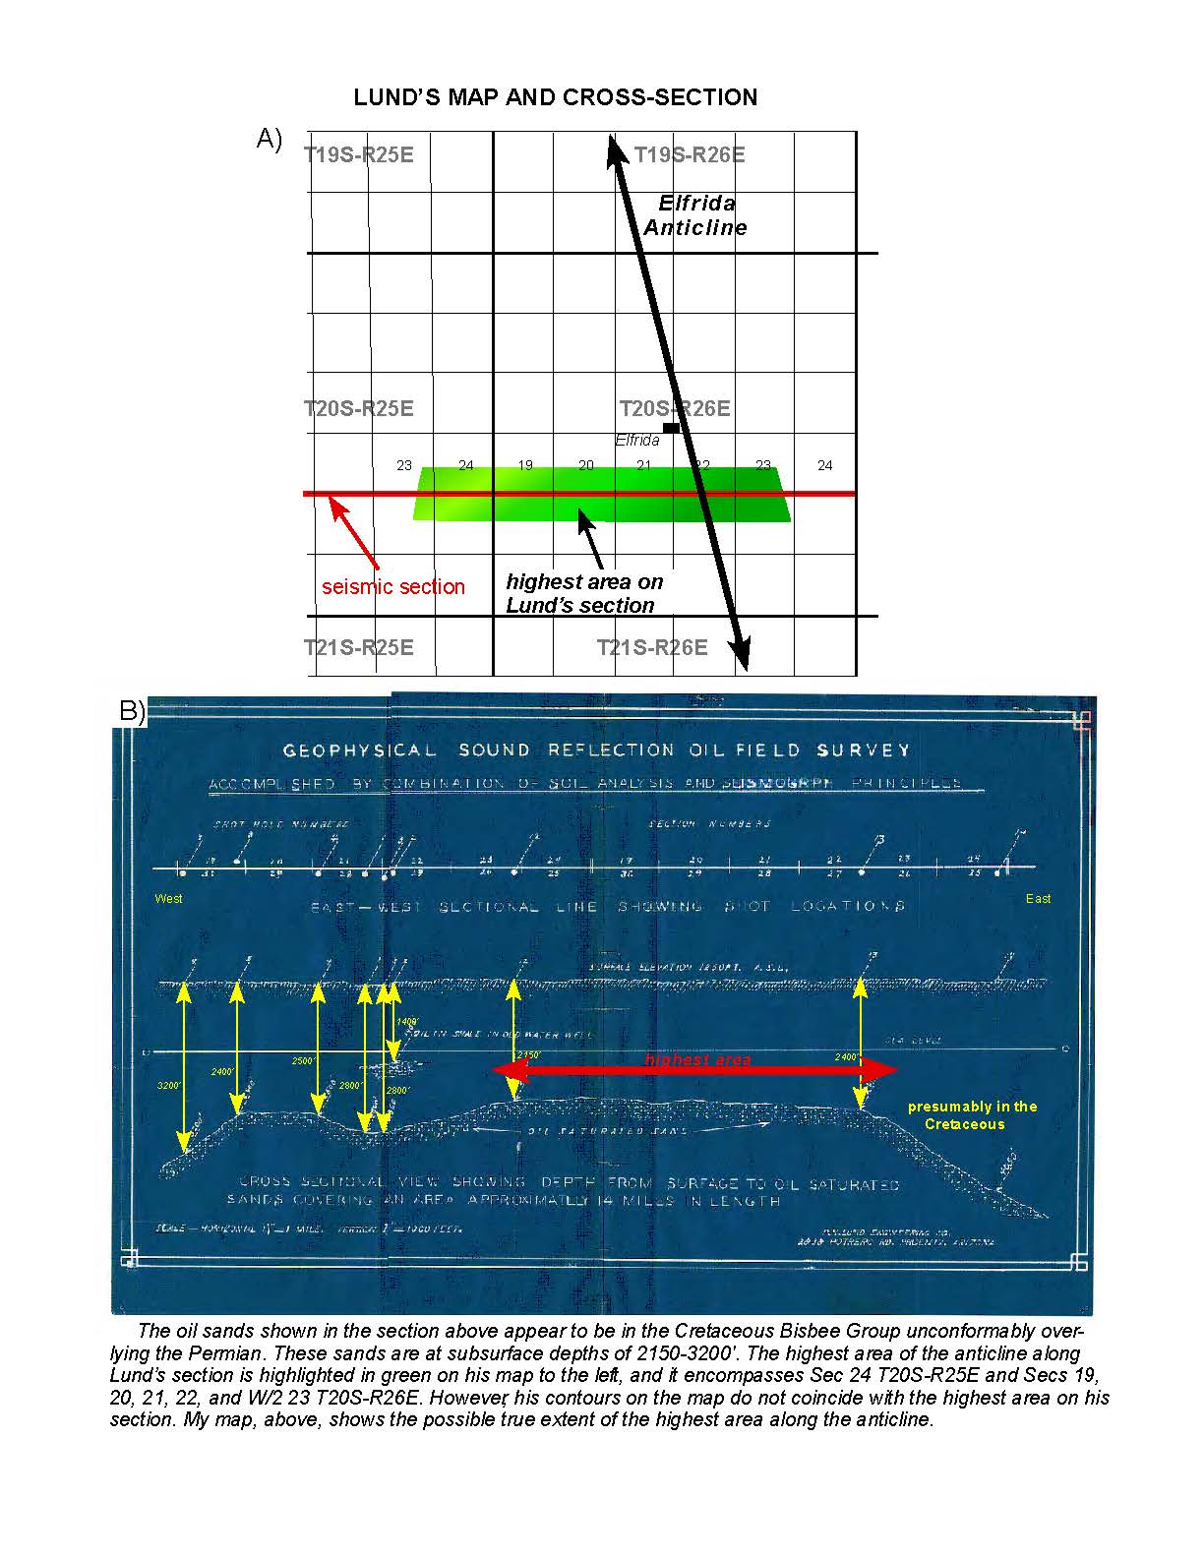
PH LUND’S
CROSS-SECTION
Based on undated early seismic and soil survey work, PH Lund shows the Elfrida Anticline

Slide 14
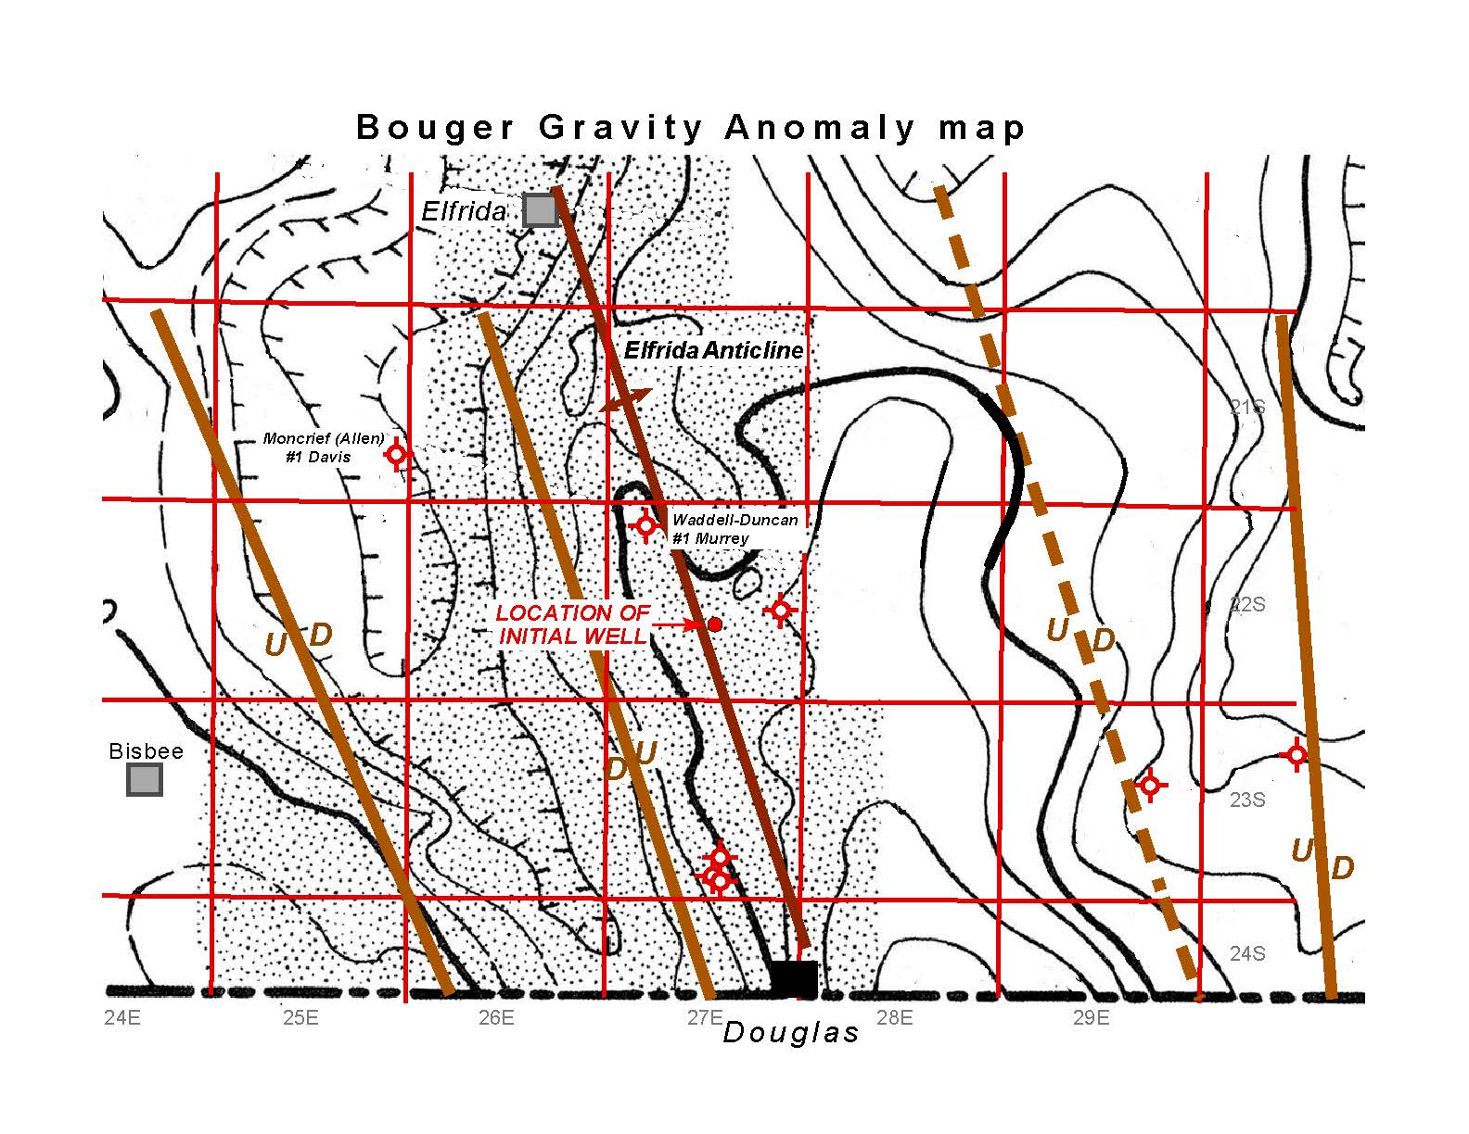

BOUGER GRAVITY MAP
Elfrida Anticline
GRABEN
GRABEN
The Gravity Map shows the locations of Grabens beside the
Elfrida Anticline, which is an upthrown ‘horst’ block.

Slide 15
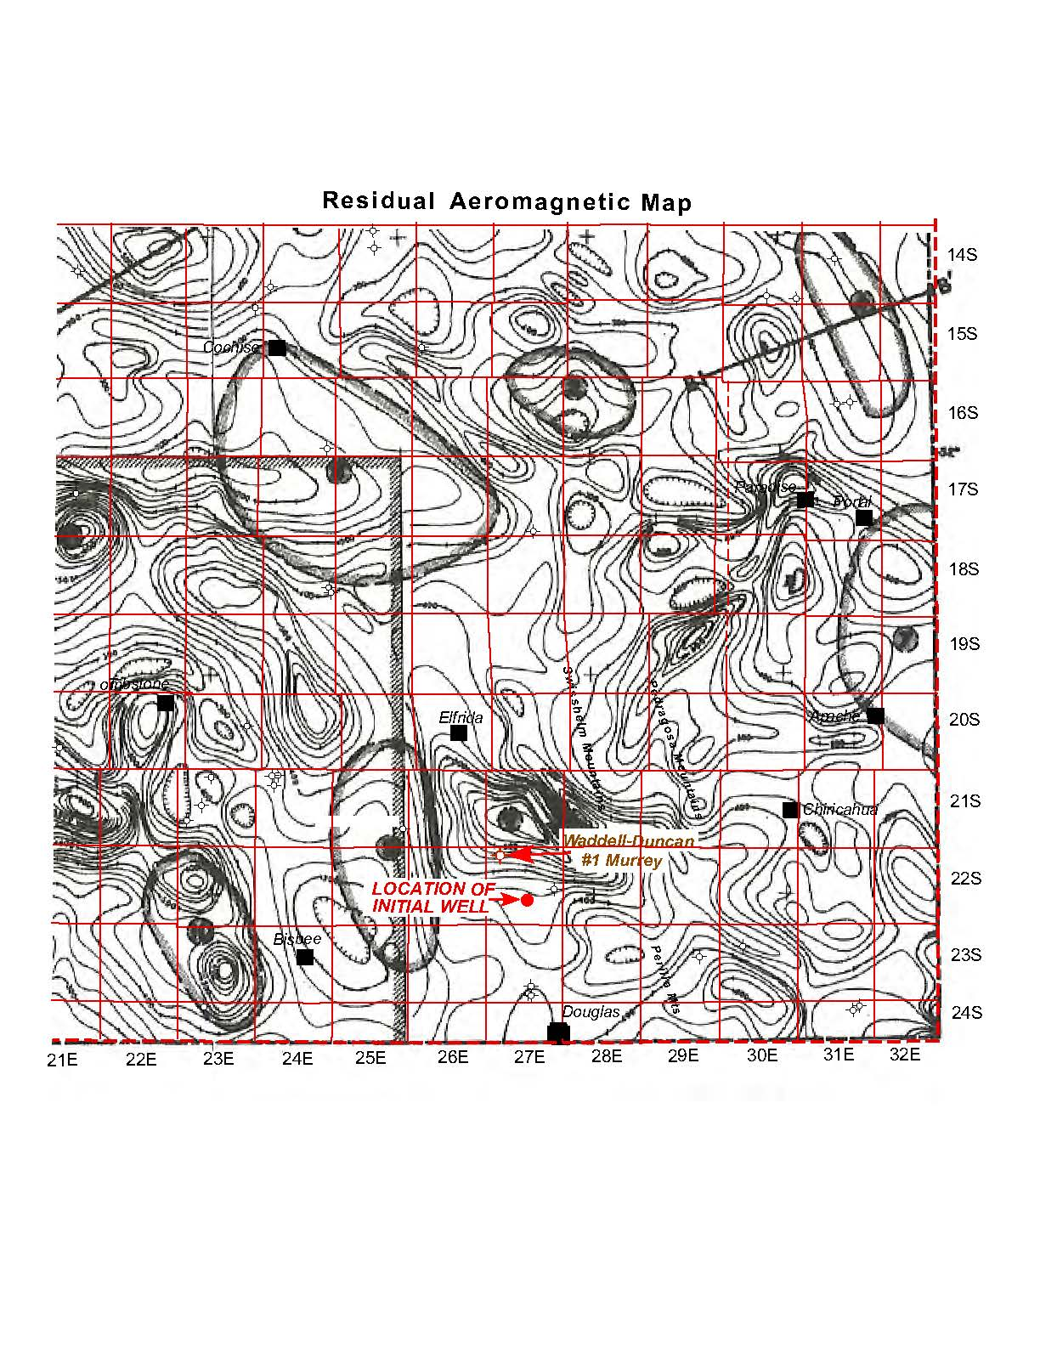
RESIDUAL AEROMAGNETIC
MAP
It is believed that moving lower on the anticline, will produce thicker pay zones, and the appearance of additional reservoir strata.
The well reported the top of the Precambrian Granite at 3990’, which verifies this contention.
The structurally high position of the Wadell-Duncan well is presumed to have suffered abnormally eroded sections of Devonian, Pennsylvanian, Permian, and possibly Cretaceous rocks.
The Aeromagnetic Map shows that the Waddell-Duncan #1 Murrey well to the northwest of the initial drilling location is on a very high feature, held up by
igneous rocks close to
the surface.

Slide 16
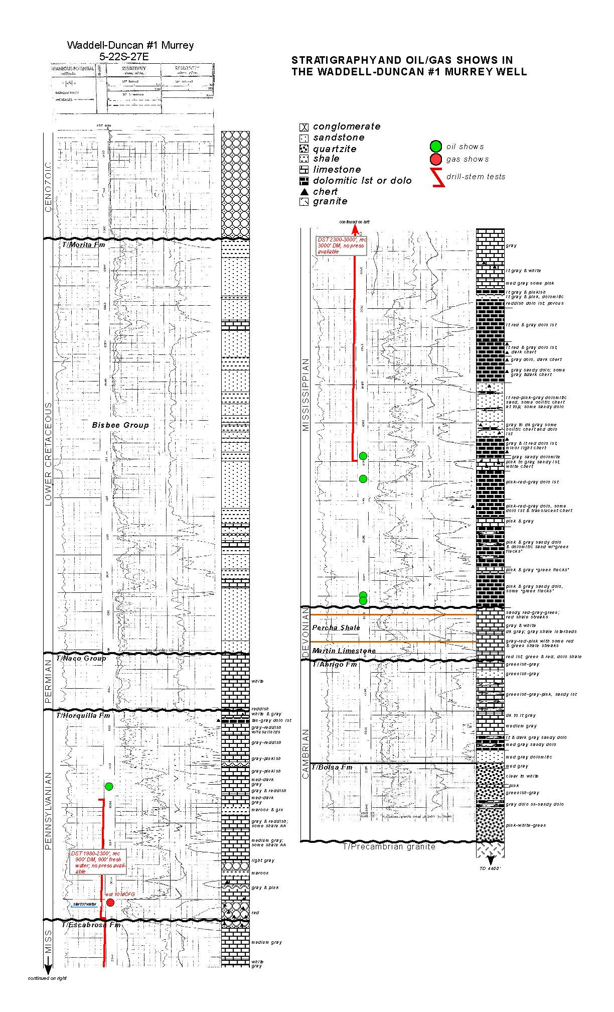
STRATIGRAPHY & SHOWS
OF OIL & GAS IN THE
WADELL-DUNCAN MURREY
OIL SHOWS
There were shows of oil & gas in the Horquilla and Escabrosa formations. The drill stem-tests recovered no oil or gas, but the intervals covered were too thick to
adequately evaluate the
shows.
Drill Stem Tests on exploratory wells should be run over small intervals of the oil shows, to properly and effectively test potential reservoirs.
GAS SHOWS

Slide 17
STRATIGRAPHY OIL & GAS
SHOWS WADDELL-DUNCAN
OIL SHOWS
There is a similarly thin section (150’) of Permian limestone overlaying the Horquilla within the Naco Group, while the Permian regionally can be as much as 1,000’.
The 530’ of conglomerates of Cenozoic age are thin relative to the 5450’+ found in the Moncrief (Allen) #1 Davis in the western graben. This is because the Wadell-Duncan well is high on the uplifted horst block to the east of the graben.
The Devonian regionally is between 300-400’ thick in the prospect area.
The Wadell-Duncan had about 50’ of limestones in the Devonian, and the Percha Shale which overlays it was about 70’ thick.
Likewise, the overlaying Pennsylvanian rocks regionally can be as much as 1,500’ thick, with the Horquilla Zone comprising 600-1230’ of that section in the County. The well showed 450’ in the Horquilla.
The Lower Cretaceous age Bisbee Group is 1,000’ – 15,000’ elsewhere in Cochise County. While the well logged 1080’ of sandstones, shales and limestones within the Bisbee Group, it is unlikely 15,000’ will be encountered outside of a graben.
GAS SHOWS

Slide 18
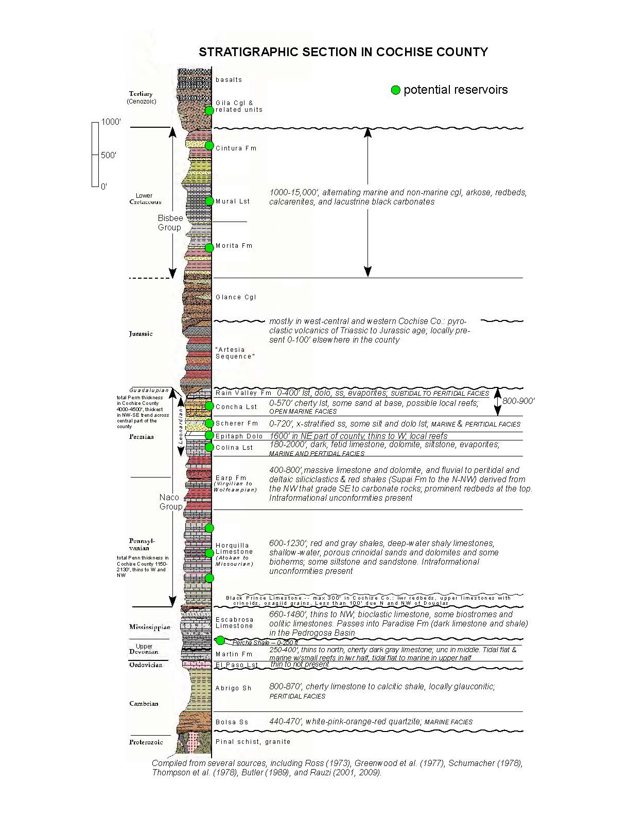
Reservoir Objectives
Mississipian Escabrosa Limestone
Gila
Permian Naco Group
Percha Shale:
Pennsylvanian Horquilla
Cenezoic: Gila and Related Units
Cretaceous Formations
Cintura
Mural
Porous limestones, dolomites and sandstones
Concha Limestone, Schrer Sandstone, Epitaph .Dolomite, and Colina
  Limestone all potential targets.
If Present, the presumed oil-saturated sandstones of Cretaceous age shown on PH Lund’s Map and Cross-Section would be in
Cretaceous beds
overlaying the Morita
Formation.
Shows of oil in the Wadell-Duncan well.
Close to the transition of the Pedragosa basin, which is prime for the
  development of reefs during deposition of rocks.
Cenezoic rocks have some reservoir potential as suggested by the shows of oil and gas in these rocks in the Moncrief (Allen) #1
Davis well in
T21S-R25E.
The Morita Limestone was reported in the Wadell-Duncan well.
  Assuming less erosion down dip, reefs could
develop in the Morita
and the Mural
Limestone Formations.
Porous limestones
Thicken to the southeast from the Wadell-Duncan
Also in prime location for the development of reefs
    Local bioherms postulated by numerous individuals.
Equivalent to the Woodford Shale in NM, TX, OK and KS.
Prolific, unconventional reservoir may be discovered if the Percha is greater than the 70’ discovered in the Wadell-Duncan.
Morita
Naco Group
Horquilla
Escabrosa
Percha Shale

Slide 19
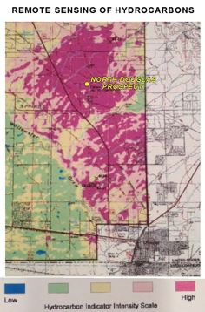
SATELLITE ANALYSIS
Remote detection (‘sensing’) of hydrocarbons seeped into surficial soils from reservoirs at depth by aerial or satellite surveys is a well-known method of exploration in little-drilled, frontier areas.

Slide 20
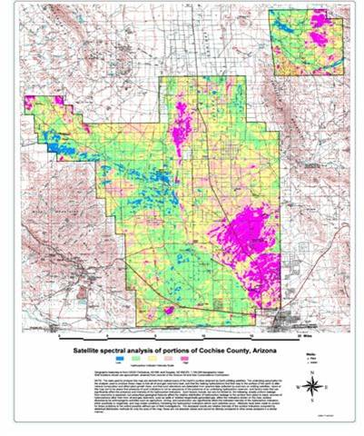
SATELLITE ANALYSIS
Hyperspectral Satellite Analysis &Radar-Sat Show Prolific Structure, Which Matches The Elfrida Anticline Mapped by Geologists.
Vegetation Anomalies, Surface Alteration Through Macro/
Micro-Seeping Gasses, Direct Detection and Ratioing of These Gasses, Ratioing of Polarizations of Radar-
All Stack on the Geology and Present:
  Red: Oil Reservior
  Pink: Oil Reservior with Natural Gas
  Yellow: Gas Reserves

Slide 21
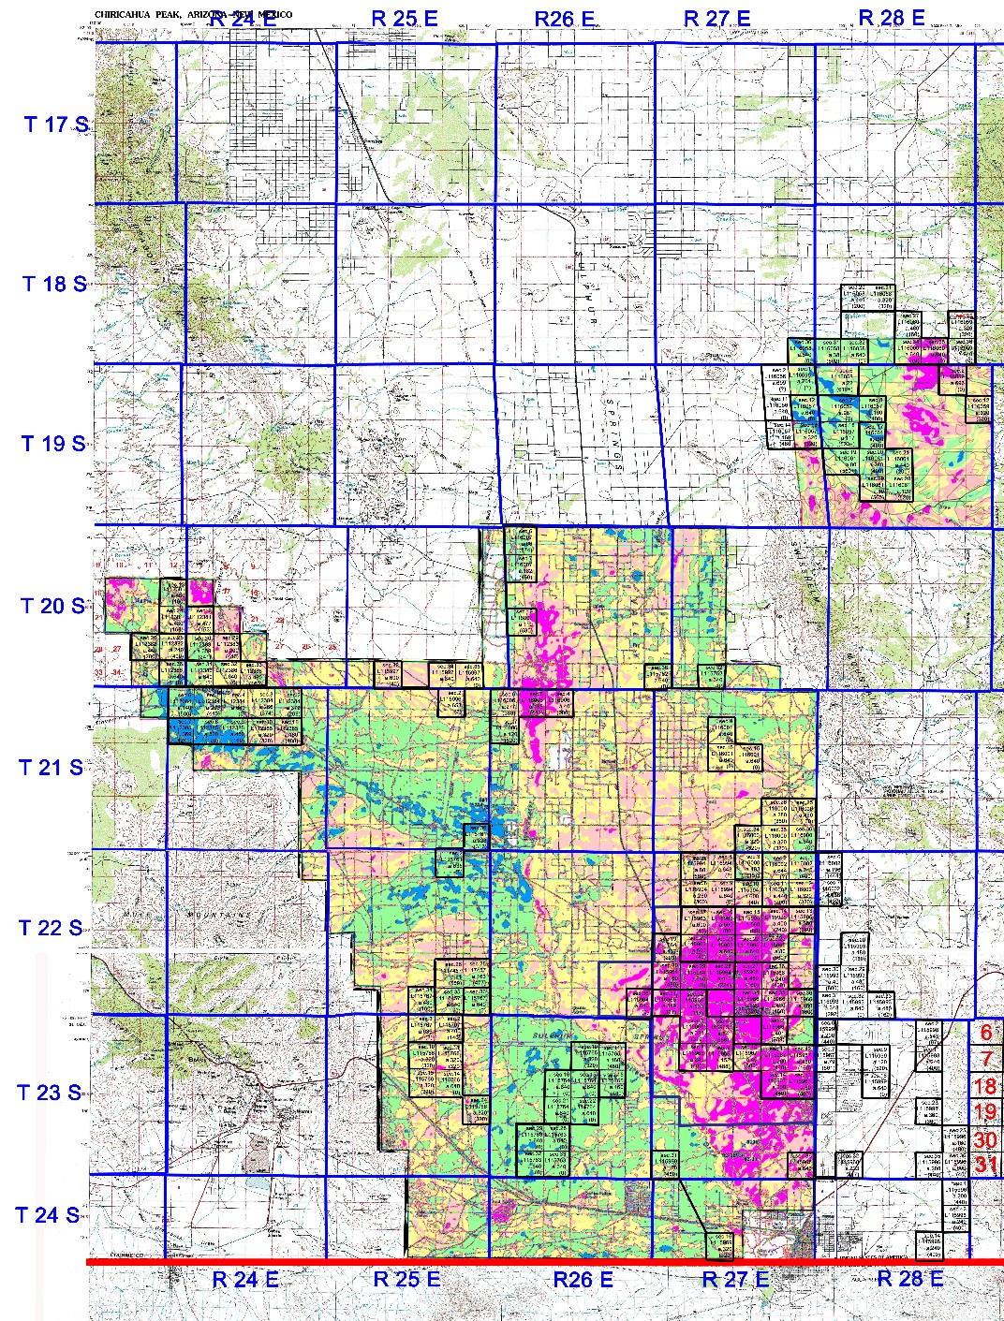
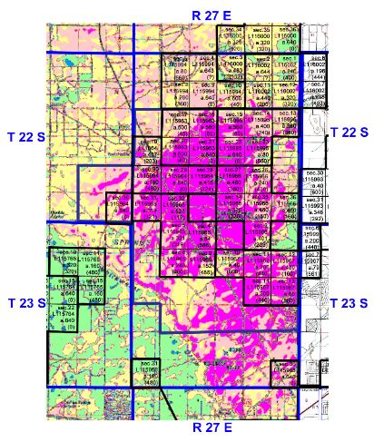
LEASE POSITIONS
All acreage outside of the specific two-township North Douglas Prospect, (39,880 acres) is offered at $75.00/acre
The North Douglas Prospect is contained within two townships shown to be potentially prolific and contains 16,846 acres which are offered at $125.00/acre.
The boxes drawn on the hyperspectral satellite map show the lease positions throughout the Sulphur Springs Valley containing 56,726 acres of oil and gas leases.
Sulphur Springs Valley Lease Positions

Slide 22
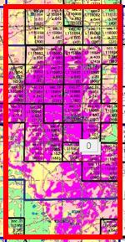
DRILLING LOCATIONS
The State of Arizona 2-22 location located in the SW SW Section 22 T22S-R27E will be drilled and analyzed to pick a value-oriented second location. for drilling.
However, the State of Arizona 1-21 located in the SW SW Section 21 T22S R27E is also permitted and approved for drilling.
The North Douglas Prospect on the Elfrida Anticline is drill-bit ready. The archeological studies have been performed, surveys have been done and two drilling locations have been staked and permitted by the Arizona Oil and Gas Conservation Commission.

Slide 23
ARIZONA OIL AND GAS
www.AZOilGas.com
Come Visit Us At Booth
841
CARMON DECKER BONANNO, President
11 North Saint James Place
Eastborough, Kansas 67206
PH: 816 – 223 – 3712
FX: 316 – 260 – 1960
CarmonBonanno@Hotmail.com

